Slide 1
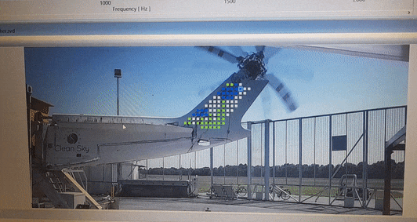
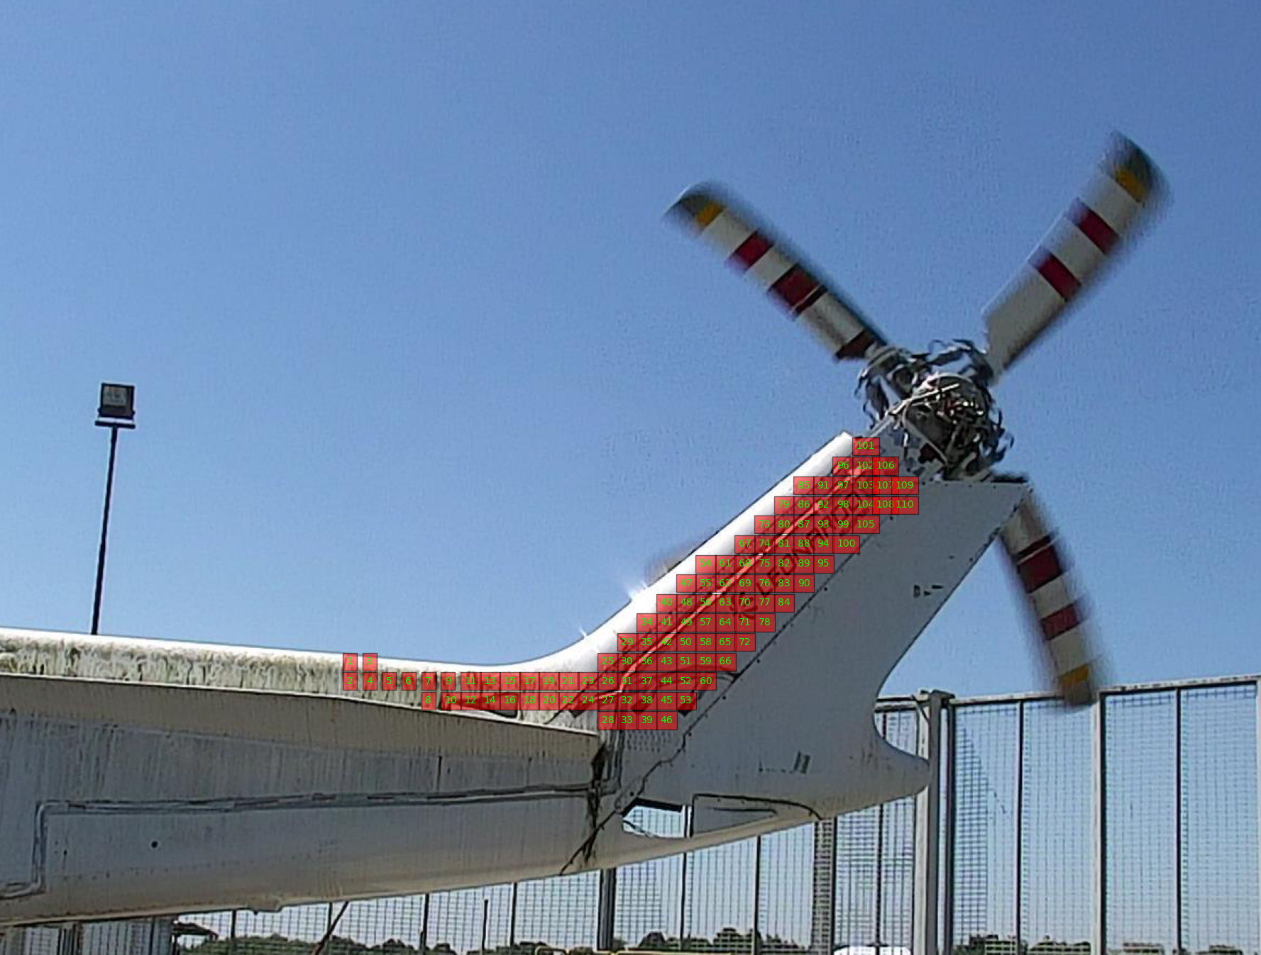

SHM
NON-CONTACT LASER INSPECTION OF HELICOPTER TRANSMISSION LINE
Network definition
network consisted of over 100 measurement points
covered areas:
TGB vicinity;
slant shaft
IGB;
drive shaft (partially);
virtual sensors network
acquisition time: 4s per point (0.25Hz resolution)

Slide 2
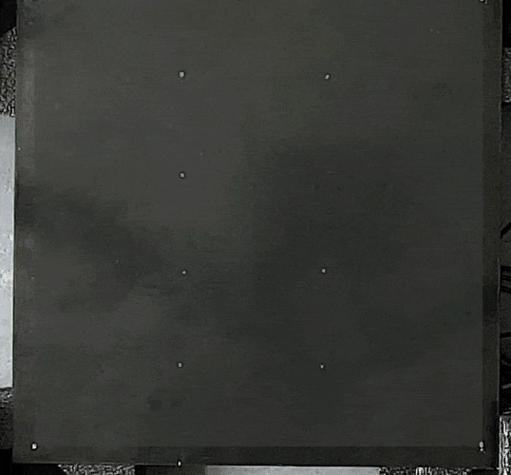
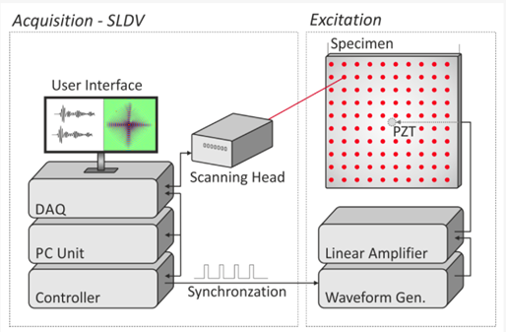

FULL WAVEFIELD MEASUREMENTS
Laser Scanning Vibrometer
measurement principle with use of LSV

Slide 3
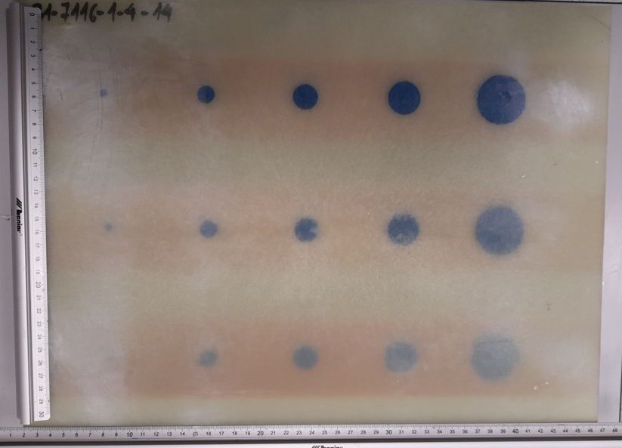
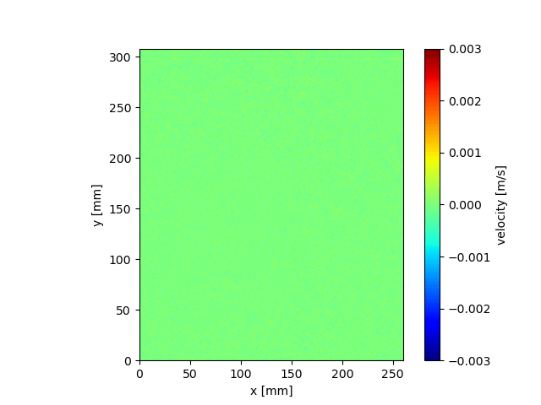
BASELINE FREE DAMAGE DETECTION WITH FULL WAVEFIELD DATA – NDI APPLICATION
acquired wavefield
17th CONFERENCE „FATIGUE OF AIRCRAFT STRUCTURES”, 11-12 January 2024

Slide 4

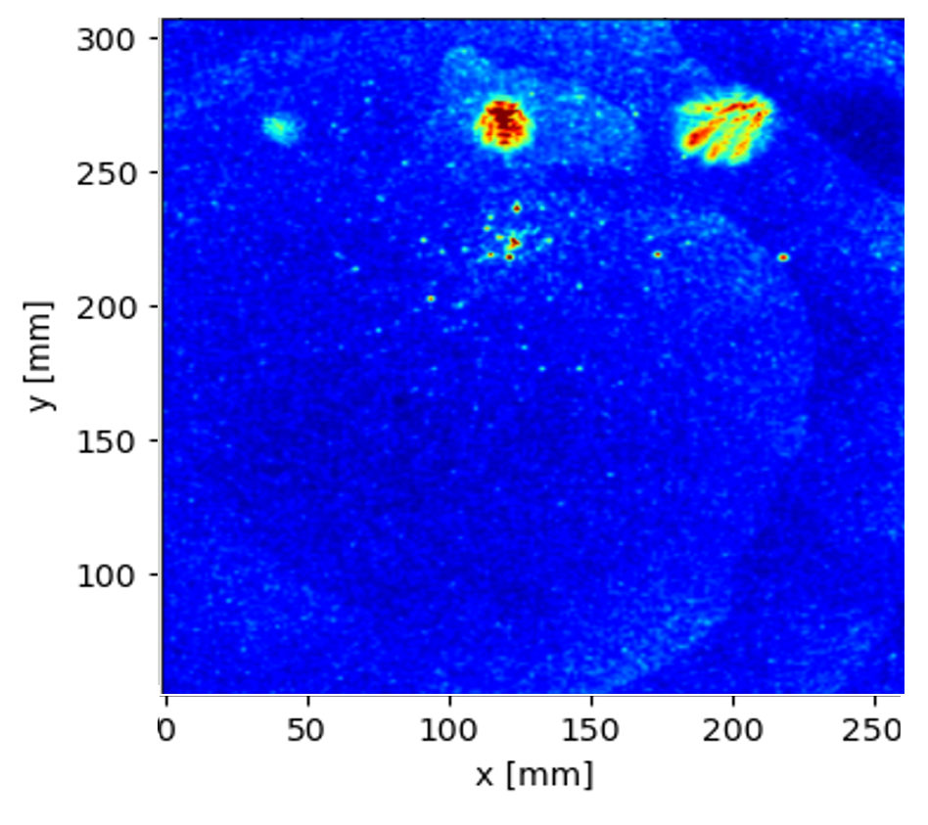
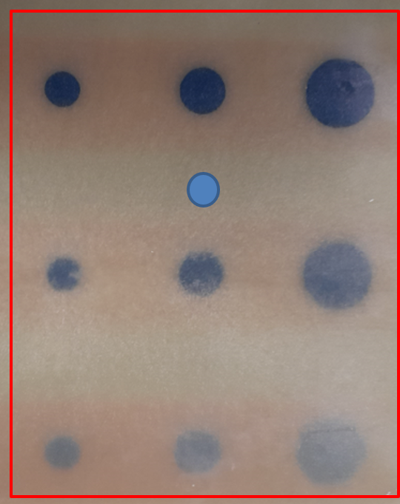
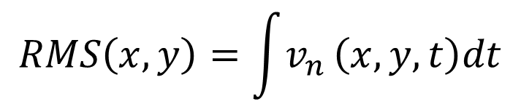
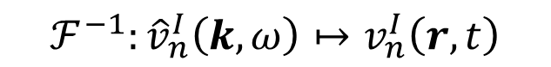
BASELINE FREE DAMAGE DETECTION WITH FULL WAVEFIELD DATA – NDI APPLICATION
$$ℱ^{−1}:{\hat{v}}_{n}^{I}\left(k,ω\right)↦v_{n}^{I}\left(r,t\right)$$
$$RMS\left(x,y\right)=\int{v_{n}}\left(x,y,t\right)dt$$
RMS map
reconstructed wavefield

